Slide 1
Online Registration
Let’s Go Live!
Notes:
Thank you for having us! We’re excited to share with you some of the exciting things our IT department has been developing to help make your job and life easier!
(click)

Slide 2
Agenda
Preparing for Go Live
My.Scouting
BeAScout
Unit Configurations
Invitation Manager overview
Digital Application overview
Application Manager overview
Online Registration Resources
www.Scouting.org/onlineregistration
Notes:
Thanks for coming today.
Our council is launching a new online registration tool that will allow your unit to sign new members up digitally and complete the entire acceptance process without having to handle a any paper. This system allows for digital signatures and online credit card payment making it fast and easy for the new applicant.
There are a few things that the unit needs to do to get ready – we will go over that
I will show you the Invitation Manager tool
The digital application that the applicant will fill out
The Application Manager tool
And, the online resources available to help you use the system.
(click)

Slide 3
Preparing for Go Live
Notes:
Before the system goes live – there are some things that a unit needs to verify are correct so that the system allows access and sends unit leaders the right notifications.
(click)

Slide 4
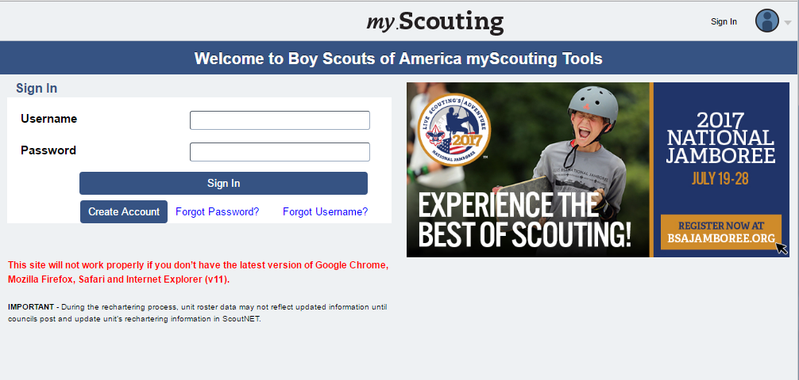
my.scouting.org
Notes:
Online registration administration tools for units are accessed through your My.Scouting account. If you don’t’ currently have an account, you will need to create one to use Online Registration. If you do have an account, make sure that your email address and the rest of your profile is current so that you get notifications and information that you need to use the new tools.
The tools contained within My.Scouting are role based. Therefore your unit needs to have the Unit Key 3 correctly registered so that they can take action in the system. So if you change Committee Chairs or your top leader, you need to get that information in to the council as soon as possible so that they can be registered correctly which will enable access to these tools.
You should do this before the Go Live date for online registration. Page 4 of the Online Registration Unit Guidebook walks you through the steps to update your My.Scouting account.
(click)

Slide 5
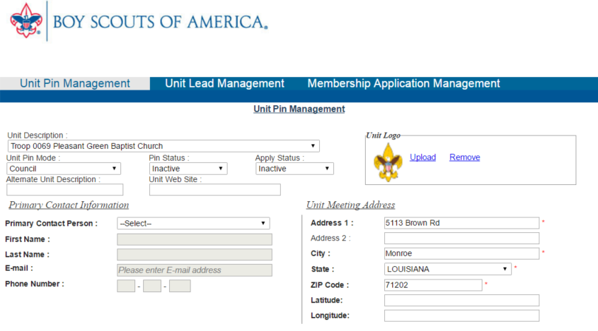
BeAScout Unit Pin
Notes:
While in your My.Scouting account, someone in the Unit Key 3 – The Committee Chair, top unit leader (Cubmaster, Scoutmaster, Crew Advisor, Coach), or Chartered Organization Representative – should go in to the BeAScout set up that can be found under legacy tools.
(click) Under unit pin management,
(click) verify that the contact information updated and correct.
(click) Also set the unit pin to Unit mode, Pin Status to Active, and Apply Status to active if you want the “Apply Now” button to show on BeAScout. If Apply Status is not set to active only the “Request More Information” button will show on BeAScout.
We recommend checking these setting and turning the pins to active status on the same day that the system goes live for your council. If you do not already have these turned on and you turn them on before we go live – the system will default to a legacy application which does not include payment options. Page 5 of the Online Registration Unit guidebook walks you through the steps to update your BeAScout pin.
(click)

Slide 6
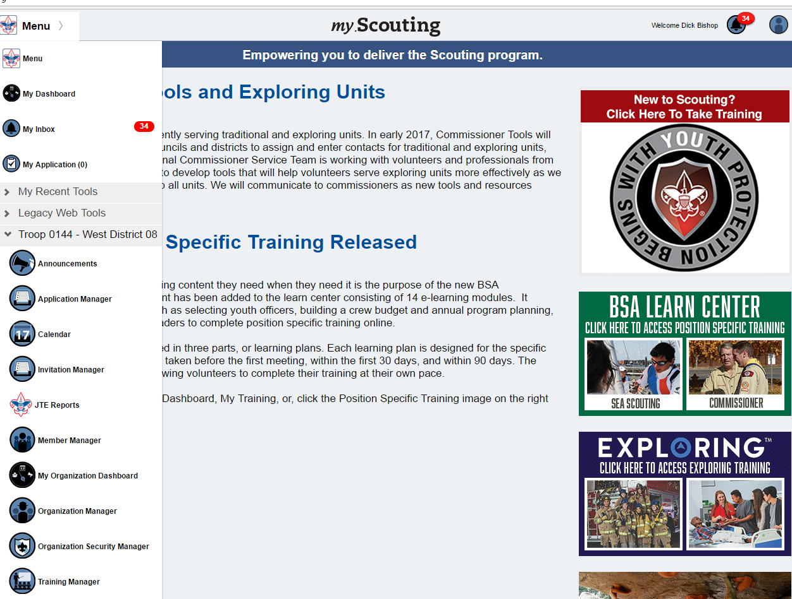
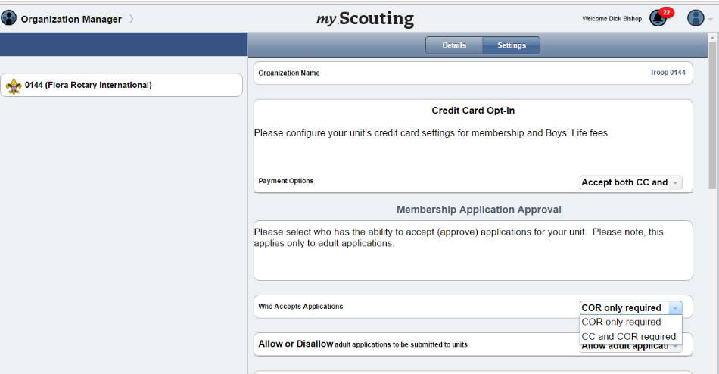
Unit Configurations
Payment options
Adult application availability
Committee Chair recommendation for adult positions
Unit Fee Message
Automated Welcome Email
Notes:
On the day that the system goes live, or after it is already live, you can go into Organization Manger and set up your unit’s Online Registration Unit Configurations. This will take you to a screen where you can select Settings and see all of the configuration options available to your unit. If the council has made them available to the unit you will have a choice of payment options and adult application availability. If either of these is greyed out, that means that the council has set these to a council-wide configuration.
(click)
Page 8 of the Unit Guidebook walks you through each of the configurations and your choices within these configurations.

Slide 7
Invitation Manager
Notes:
Invitation Manager is a tool where the leads – families who indicate they want more information about Scouting through BeAScout – will come in for your unit to contact. These are people who really want to get involved, they are just waiting for you to contact them and let them know more about your unit.
Invitation manager can also help you manage leads that come in through joining nights or through personal invitations to join. I’ll show you how to do this in a minute.
(click)

Slide 8
Who has access?
Unit positions that have full access to the Invitation Manager Dashboard to add leads, manage inquiries from prospective Scouts, and send joining invitations:
Chartered organization representative (CR)*
Committee chair (CC)*
Unit leader (Cubmaster, Scoutmaster, Crew Advisor, Skipper, Coach)*
Institutional Head/Chartered Organization Executive Officer (IH)
Unit membership chair
* = Members of the Unit Key 3
The Unit Key 3 can assign a “Registration Inquiry” functional role to other unit volunteers who need read only access to view lead status and submitted requests.
Notes:
First I want to help you understand the positions that can take action in Invitation Manager. The unit Key three the head of the Chartered Organization and the Unit membership chair all have access to see and respond in this tool. The Key 3 of the unit can also assign a functional role of Registration Inquiry which will grant view only access for submitted requests. This person will be able to see the request, but cannot sent the invitation or take an action in the tool.
(click)

Slide 9
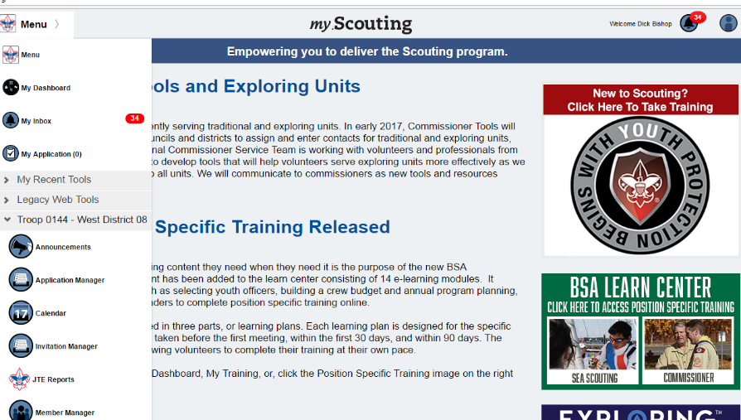
Notes:
Once the system goes live for the council, leaders in the unit that have access will see invitation manager in their drop down menu after they select the unit in which they wish to work.
(click)

Slide 10
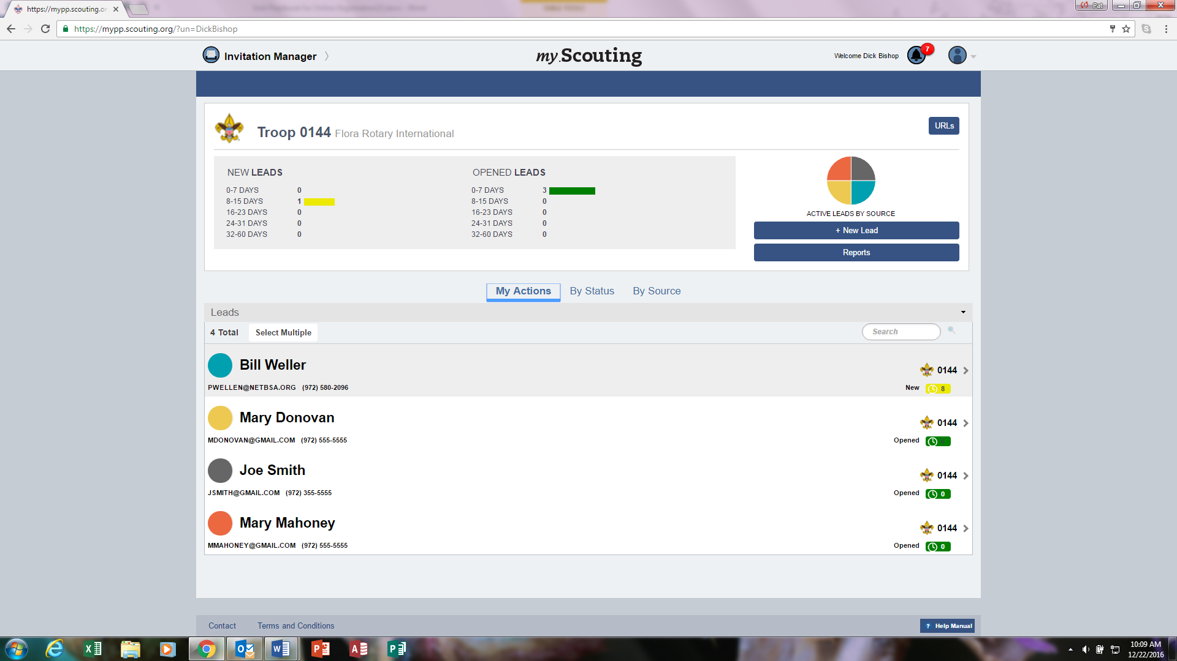
Notes:
Invitation manager will open in the My Actions tab – this tab shows you all of the requests for information on which you need to take action.
(click) You can also look at the leads by status or
(click) by source.
(click) If you want to add a new lead you can select the button for adding a lead and a new window will appear.

Slide 11
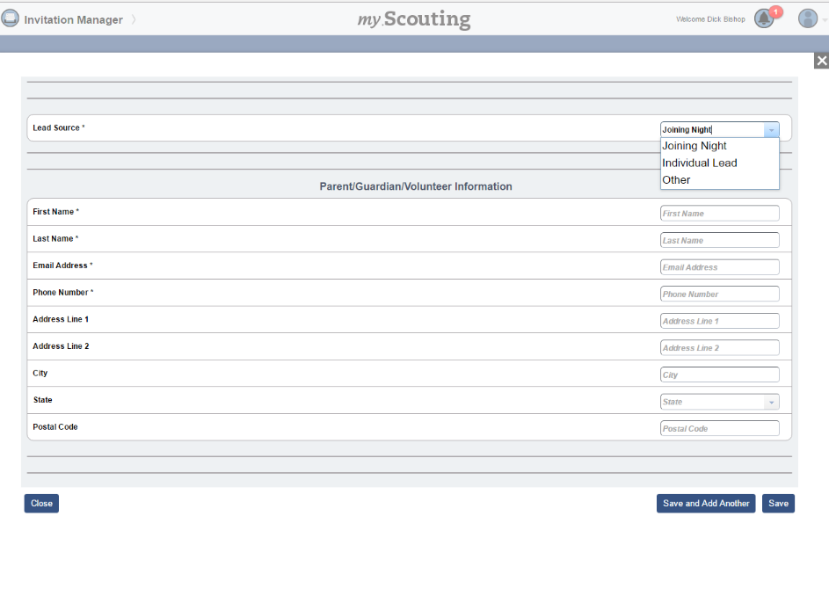
Notes:
After you select add a new lead this screen will appear. You can select the lead source from the drop down menu. You can use this to enter individual leads that you get through word of mouth.
You can also use this at joining night as your sign in page if you have internet access where you are holding the rally. One of the Key 3 would just log in to their My.Scouting account and open this page, select Joining Night as the lead source and then have the parent use the iPad or laptop to fill in their contact information then ask them to select save and add another so that the next person can sign in. Before the meeting starts someone in the unit would close this form which will take them back to the MyActions page – they would Select the By Status tab the select Joining night and select everyone in that status and send the invitation. Parents will get the invitation on their SMART phone and will be able to fill it out while they are attending the joining night or they can always fill out the paper application if they prefer to apply that way. If they apply online, One of the key 3 can go in and accept the youth applications as they are submitted and the applicant will leave the meeting having received their welcome email and their member number.
(click)

Slide 12
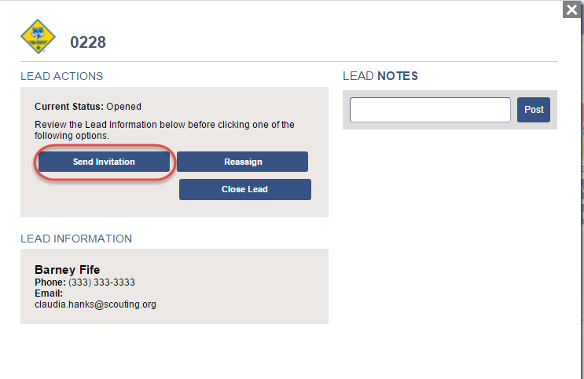
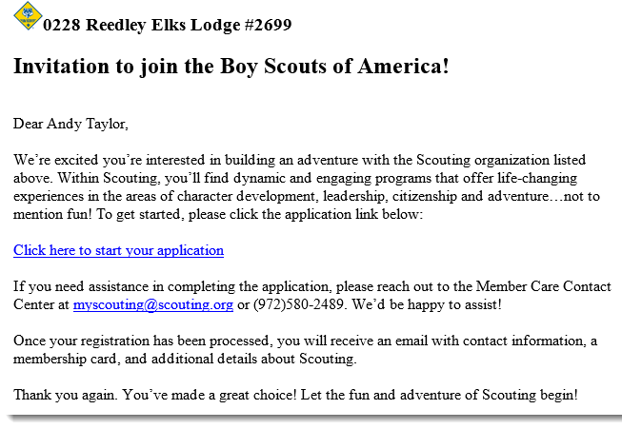
Notes:
Once you have leads in the system, you can review the lead information. You can add notes about any actions you have taken to contact the lead – this lets the others in your unit who have access to process leads know what you have done.
You can send an invitation.
You can reassign the lead to the district if there is some reason you cannot take the person into your unit.
Or, You can close the lead if the person turned in a paper application or if the person tells you they are no longer interested in joining. This will take them out of your actions and out of your reminder emails.
(click) This is what the invitation generated by the system looks like. It will have the program symbol and your unit number and your chartered organization name at the top. The link will be specific to your unit – so anyone using this link will fill out an application that goes into your Application Manager tool where you can review and accept the applicant.

Slide 13
Notes:
If you don’t have internet access at the joining event, parents can still use their phones to fill out the online application. You will just need to provide the units URL or QR code that links to your units application. Select URL’s at the top right hand corner of your screen
(click) and a window will open with your unit’s URL and QR code. Just copy and paste these on your fliers or in your personal emails to invite others to join your unit.
Remember when using the URL or QR code that it is specific to your unit. If you put it out on social media and someone from Timbuktu sees it and clicks it – they are applying to your unit. So, it is best not to use this link on your social media page where the public could get to it.

Slide 14
Digital Application
Notes:
The digital application asks for the same information as the paper application. It just presents it in a format that is easy to fill using a digital device.
(click)

Slide 15
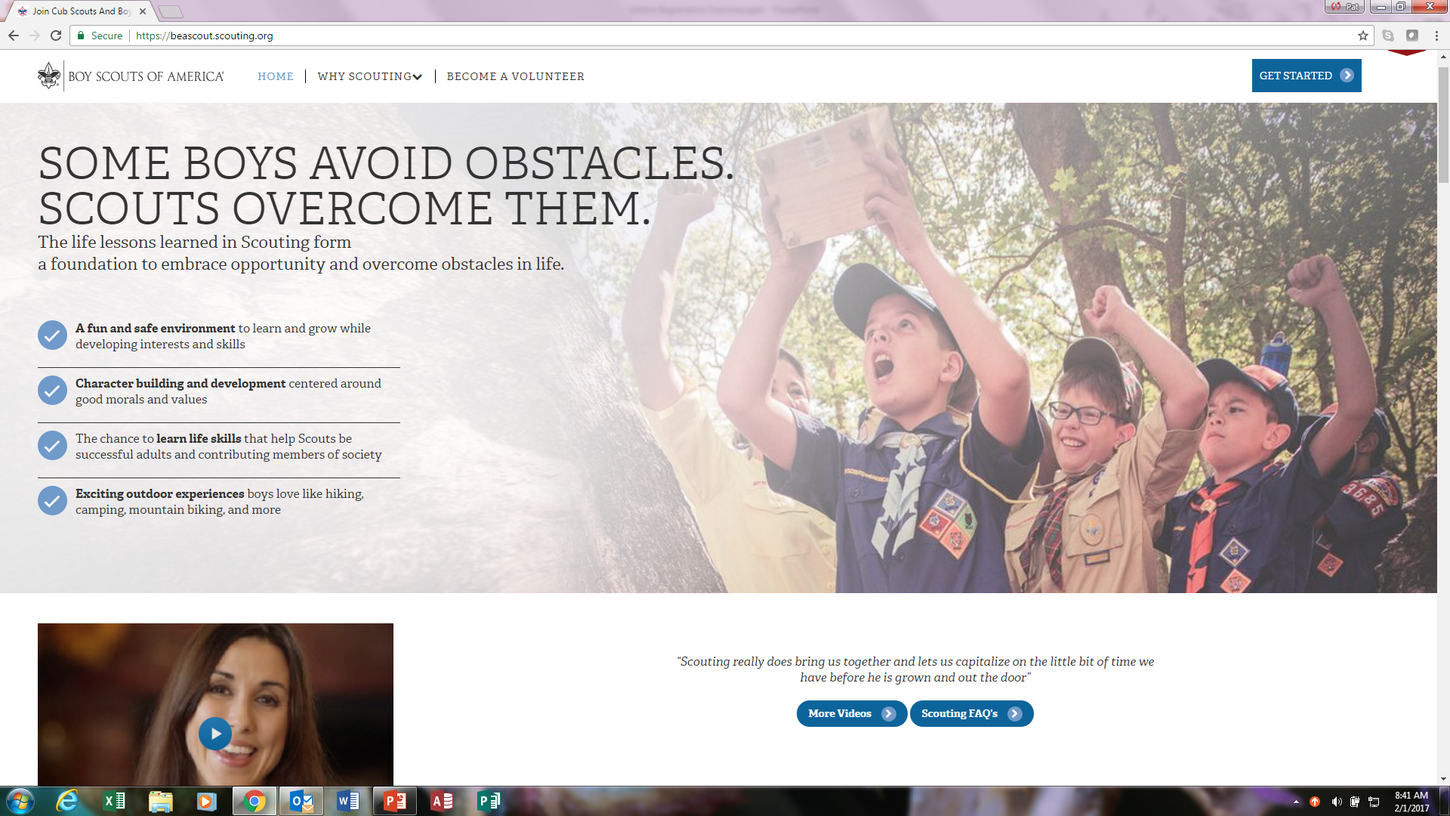
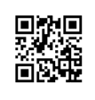
Three ways to start an application
BeAScout
Unit specific URL
QR code
Notes:
There are three ways that a family who wants to join Scouting can access the online application. One way is through BeAScout which is a web portal that allows parents to input a zip code and find nearby units. The other two ways are initiated by unit – through a URL that is attached to an email or through the use of a QR code which I just showed you how to access in the Invitation Manager tool.
(click)

Slide 16
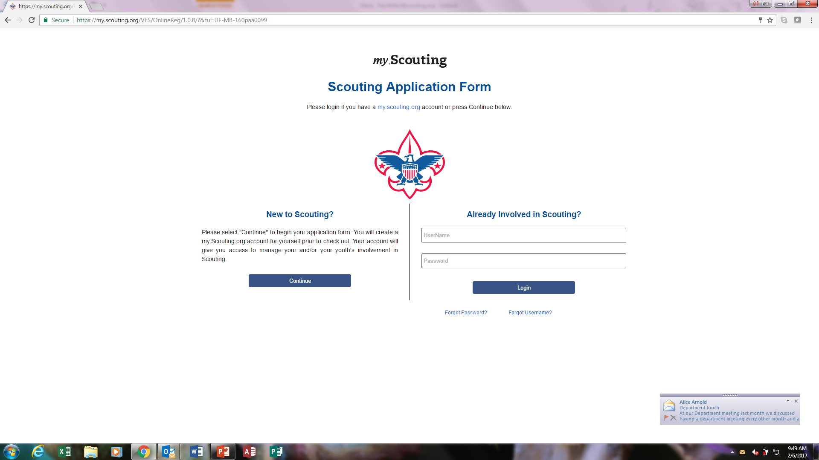
Starting an application
Notes:
When a parent scans the QR code, opens the URL link that is emailed, or selects the Apply Now button in BeAScout they will see this screen. Here they can select New to Scouting if the child has never been in Scouting. If the child has been in Scouting before and is returning after a lapse in membership they can also go in, using their member number, and register through this system.

Slide 17
Add video for App Entry
Notes:
(make sure you have the video entitled “AppEntry” loaded on the computer you are using to show this PowerPoint to use this slide) if not you can just delete this slide and not use the video. If you have the video loaded and linked when you hover at the bottom of the slide you should see a start arrow for the video player – that will begin the video.)
So let me show you a short video so that you can see what the application looks like from the applicants point of view.
(Start Video – be sure to embed the hyperlink from the video that is downloaded to your computer)
The application has all of the fields you will find on the paper application. The required fields have a red star by them all other fields are optional.
The application has programming behind it to know the registration rules, so it will automatically check the date of birth of the youth to ensure they meet the program requirements.
You will see that they have the terms and agreements – they can select to have these emailed to them if they wish. They sign their name digitally. They are then taken to create account so that they can finish creating a My.Scouting account which will provide an ID number which will become their member number once you accept their application. In account creation the system automatically checks to make sure they do not already have a My.Scouting account – we don’t want to give them a new member number if they already have one. If it find a match (it matches name, city, state, zip) then it will show the possible matches and ask the registrant if that is them, if they say yes then it links this registration to that member number when they are accepted by the unit.
Next the applicant is taken to the invoice and payment options where they can complete the transaction. They can select to pay by credit card, or cash/check depending on configurations set by the Council and by the unit.
The applicant is then sent an email telling them that their application has been submitted and is in review by the council.
If they are applying as a volunteer, the email will also have a link to Youth Protection Training and will tell them that they need to complete the training before having contact with any youth and that they have 30 days in which to take the training. The system does not check to ensure that the training is completed, that is still the responsibility of the unit.

Slide 18
Application Manager
Notes:
Now lets look at the tool where you can review and accept applicants.
(click)

Slide 19
Key Unit Roles in Application Manager
Unit Position | Actions
Chartered organization representative (CR)* | Review and accept or reject unit’s adult leader applications. This is the only role that can accept or reject adult applications. Reviews and accepts or rejects unit’s Venturing adult participant applications. Can review and accept or reject unit’s youth applications (shared unit Key 3 role.)
Unit committee chair (CC) | Can review unit’s adult applications and make position recommendations to the CR. Can review and accept or reject unit’s youth applications (shared unit Key 3 role.)
Unit leader (Cubmaster, Scoutmaster, Crew Advisor, Skipper, Coach ) | Reviews and accepts or rejects unit’s youth applications (shared unit Key 3 role – primary)
Notes:
The positions that can take action in this tool are governed by the BSA By Laws and Rules and Regulations. Therefore, only the Key 3 or the unit can take action in this tool. You can give others “Registration Inquiry” function where they can view applications, but they will not be able to take action since they are not allowed to approve applications.
The Chartered organization representative is the only person who can accept an adult applicant.
If the unit elects to turn on the “CC Recommendation” configuration in the tool. The Committee Chair will have the responsibility to review the adult applications and assign the adult position. The CR will still need to accept the adult in the system after the CC assigns the position.
Any one of the unit Key 3 can accept a youth applications, However, the Unit leader has the primary responsibility for youth approval.
(click)

Slide 20
Add video for AppAccept
Notes:
(To play this video you must have “AppAccept” loaded on your computer – if you do not have this loaded on the computer you are using delete this slide and just show the remaining slides – start the video by clicking on the finger icon or the play button at the bottom of the slide when you hover.)
This is a really quick view of the tool just so you can see how it works. I’ll go through each of the screens in more detail in a minute – this is just so that you can see how the tool works and how easy it is to use.

Slide 21
Opening Application Manager
Notes:
When you log in to your My.Scouting account and select the drop down menu you first need to select your unit name and then application manager.
(click)

Slide 22
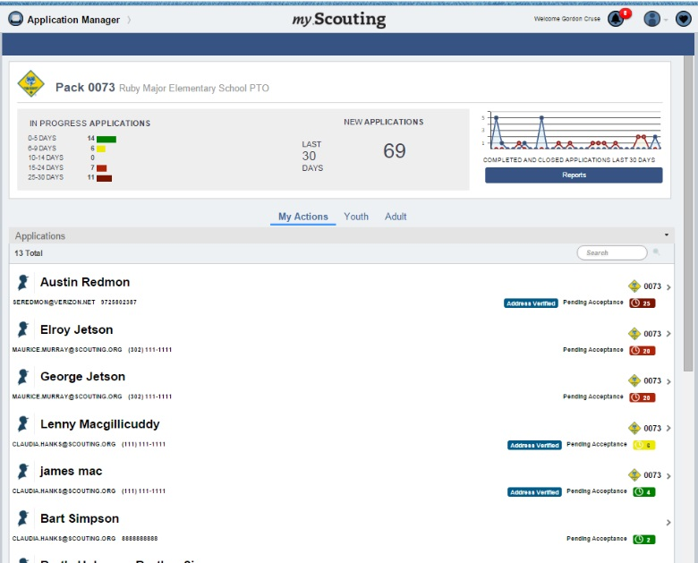
Notes:
That will take you to your (click) “My Actions” tab in Application manager. (click) On the dashboard you will see a summary of the applications in progress by age – remember that all applications will time out if you don’t accept them within 30 days. And, the clock does not start over with each action you take in the system – it starts the day the applicant presses the submit button until you take some type of action that completes or closes the application.
(Click) You can also see how many applicants have come in over the last 30 days and how many completed and closed applications have been processed over the last 30 days. As well as a button for downloading system reports.
(click) On the right hand side of the screen you can see the status that the application is in – here we can see that the application is pending acceptance.
(click) At the top, you can also go into the youth tab or the adult tab and view the applications in each of the status.
(click) You can select the name of the applicant and open the record to view the information and take action on the application.
(click)

Slide 23
Acting on an application
Notes:
When you open an application you will see the actions that you have available in the blue buttons. (click) You can accept the applicant, reassign the applicant to the district so the district can find another unit for the applicant, return the application to the applicant because you want additional information, or you can recommend this person not be accepted in Scouting. We will go over each of these actions in more detail.
(click) First let’s review the application – you have some summary information visible that you can see without opening anything else – for a youth it will show you the basic information on the application. For an adult it will show you the information you need to understand this applicants background. As you scroll down you will see the record locator for this applicant and their payment information.
But – you might want to look more closely at the information an applicant has provided. To do this you would select Review Application.
(click)

Slide 24
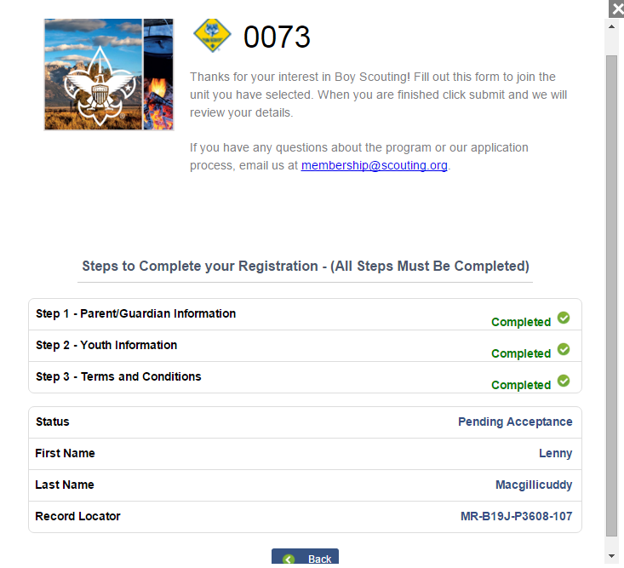
Reviewing the Application
Notes:
You can check each of the three parts of the application by clicking on the step – the form will open and you will see all of the field that are on the paper application – with the exception of the Social Security Number for adults – this is only used for background checks performed by the National Service Center, so it is not visible to the unit.
(click)

Slide 25
Accepting an Application
Notes:
After you have reviewed the application and you know you want this youth in your unit you can press the accept button and they will move to completed status if they have paid by credit card and they will be on your membership roster in My.Scouting. They will also receive a welcome email from the National Service Center and if your unit has elected to do so, they will also receive an auto generated welcome email with your units message.
If the applicant selected to pay by cash or check they will move to the pending payment status. The unit should collect a copy of the receipt the applicant was emailed along with the amount owed as stated on the receipt. The unit must collect the amount listed on the receipt and cannot prorate the amount any further. This is the amount must be turned in to the council with the application so that the council can mark the application as paid. Once the council has marked the application as paid the family will be sent the welcome email.
(click)

Slide 26
Assigning Adult Position
Notes:
When you select “Accept” on an adult application a screen will appear for the committee chair or the chartered organization representative, depending on how the unit set their configurations, so that they can select the adult position in the unit. Once the position is selected and saved, the Chartered Organization representative can complete the acceptance of the adult application.
(click)

Slide 27
Reassign
Notes:
If you select reassign, you will be asked to give a reason that you are not accepting this youth or adult into your unit. You will select from a drop down list. The application will then be forwarded to the district for one of the district Key 3 to reassign to another unit. If you look in the youth or adult status tabs you will see the application in Pending reassignment status until someone at the district takes action.
(click)

Slide 28
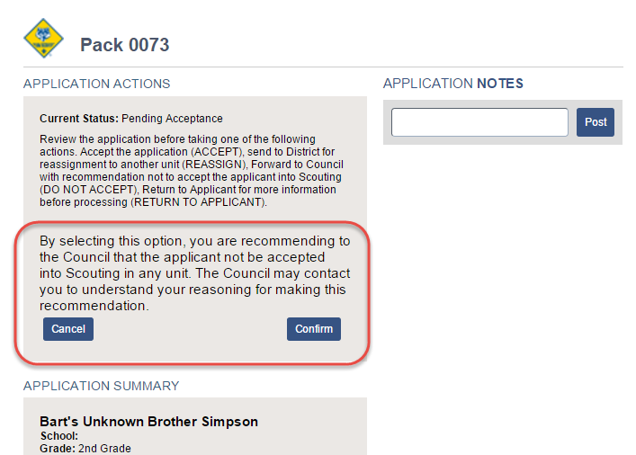
Do Not Accept
Notes:
If you select do not accept this means that you are saying they should not be accepted into any Scouting unit. You will be asked to confirm this selection. You should not give your reason on this screen – if the council has questions they will contact you for further explanation.
(click)

Slide 29
Return to Applicant
Notes:
Sometimes the unit might want a little more information from the applicant, so there is a way to return the application and write a short message explaining the additional information you need from the applicant. When confirm the message, an email will be sent to the applicant asking for the additional information. If you do not hear back from the applicant, you may want to follow up by other means to ensure the application is processed within the 30 day time period.
(click)

Slide 30
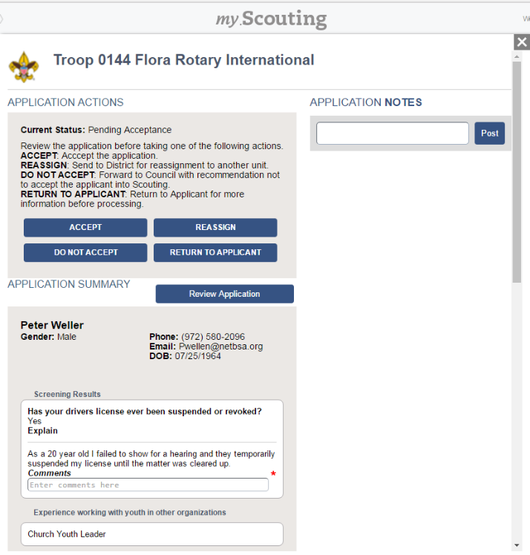
Adult Screening Questions
Notes:
If you are accepting an adult and they answered “Yes” to any of the screening questions, you will see that in the application summary. Before you can accept this person, the COR will have to add a comment in the space provided explaining their reason for accepting. After you have entered your comments and pressed return you will see the comment added in the notes section.
(click)

Slide 31
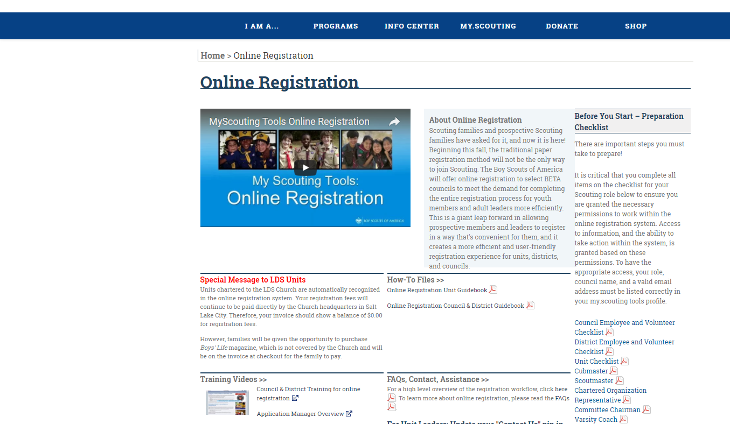
www.Scouting.org/onlineregistration
Training
Guidebooks
Checklists
Notes:
Scouting.org/onlineregistration provides online training and guidebooks that provide step by step instructions. There are also other resources such as frequently asked questions that you may also find helpful.
(click)

Slide 32
Questions??

